Slide 1
AGENTIC AI & RAG CAPSTONE · PROBLEM STATEMENT 3
Workday Data Query
and Reporting Agent
A natural-language-to-SQL agent that turns ad hoc HR questions into validated,
schema-grounded answers — in minutes, not days.
FastAPI
LangGraph
ChromaDB
SQLite
React + Vite
01

Slide 2



THE BUSINESS PROBLEM
Ad hoc HR questions shouldn't take days
HR and IT leaders on Workday-style systems need fast answers — headcount on leave by region, average
time-to-fill — but today must file a request with a report-writing team or learn a report builder themselves.
Multi-day delays
Simple questions wait behind a report-writing team's queue.
EXAMPLE QUESTION
“How many employees are
currently on leave, broken
down by region?”
A steep tool learning curve
Leaders must learn a dedicated report-builder tool to self-serve.
Stale answers, or none
THE GOAL
Leaders give up and fall back on outdated, previously generated reports.
Turn plain English into a validated, schema-grounded query — answered in minutes, with the data to back it up.
02

Slide 3







THE SOLUTION
One question in, one trustworthy answer out
A LangGraph agent retrieves real schema via RAG, drafts SQL constrained to that schema, validates and
executes it read-only, then checks its own answer against the results before responding.
1
2
3
4
5
6
→
→
→
→
→
Natural-
Language
Question
Schema RAG
Retrieval
(ChromaDB)
SQL
Generation
(scoped)
Safety
Validation
(read-only)
SQLite
Execution
Faithfulness
Check +
Answer
Follow-up drill-downs, handled natively. Conversation memory keeps the prior question and SQL in state, so “now break that down by department” reuses context instead of starting over.
03

Slide 4
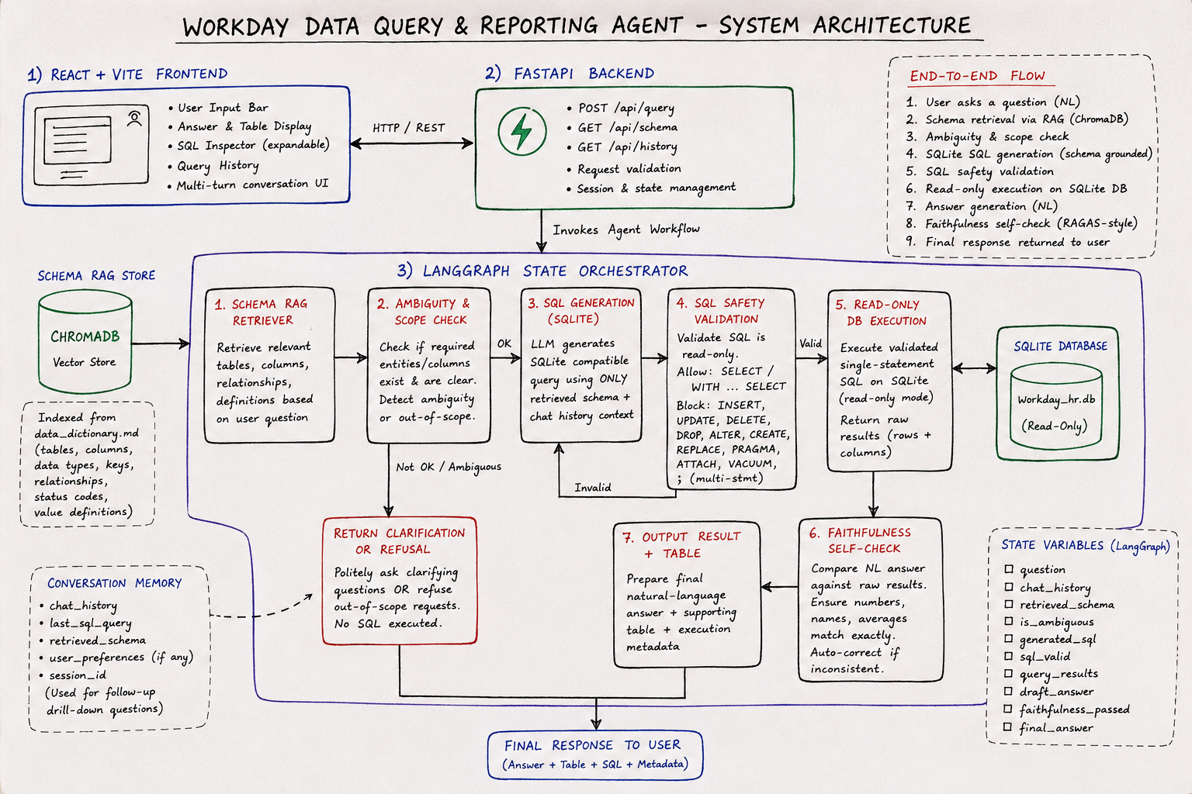
DETAILED ARCHITECTURE
The full pipeline, end to end
05

Slide 5
KEY CHALLENGES
Designed against the three hardest failure modes
Hallucinated schema
CHALLENGE
HOW IT'S SOLVED
Generating SQL against tables or columns that don't actually exist.
SQL generation is constrained to schema retrieved live from ChromaDB — the model never invents a column.
Subtly wrong answers
CHALLENGE
HOW IT'S SOLVED
A query runs successfully but quietly answers a different question than what was asked.
A dedicated faithfulness self-check compares the drafted answer against the raw result set before it's returned.
Follow-up drill-downs
CHALLENGE
HOW IT'S SOLVED
“Now break that down by department” shouldn't mean rebuilding the whole query.
LangGraph state retains chat_history and the last SQL query, so drill-downs reuse prior context.
06

Slide 6



TECHNOLOGY STACK
Built on a lightweight, production-shaped stack
Python
FastAPI
LangGraph
Core language for the agent and services
REST API — /query, /schema, /history
Sequential plan→generate→validate→answer graph
ChromaDB
SQLite
React + Vite
Vector store for schema / data-dictionary RAG
workday_hr.db — read-only execution target
Dashboard: answers, table, SQL inspector, history
07

Slide 7
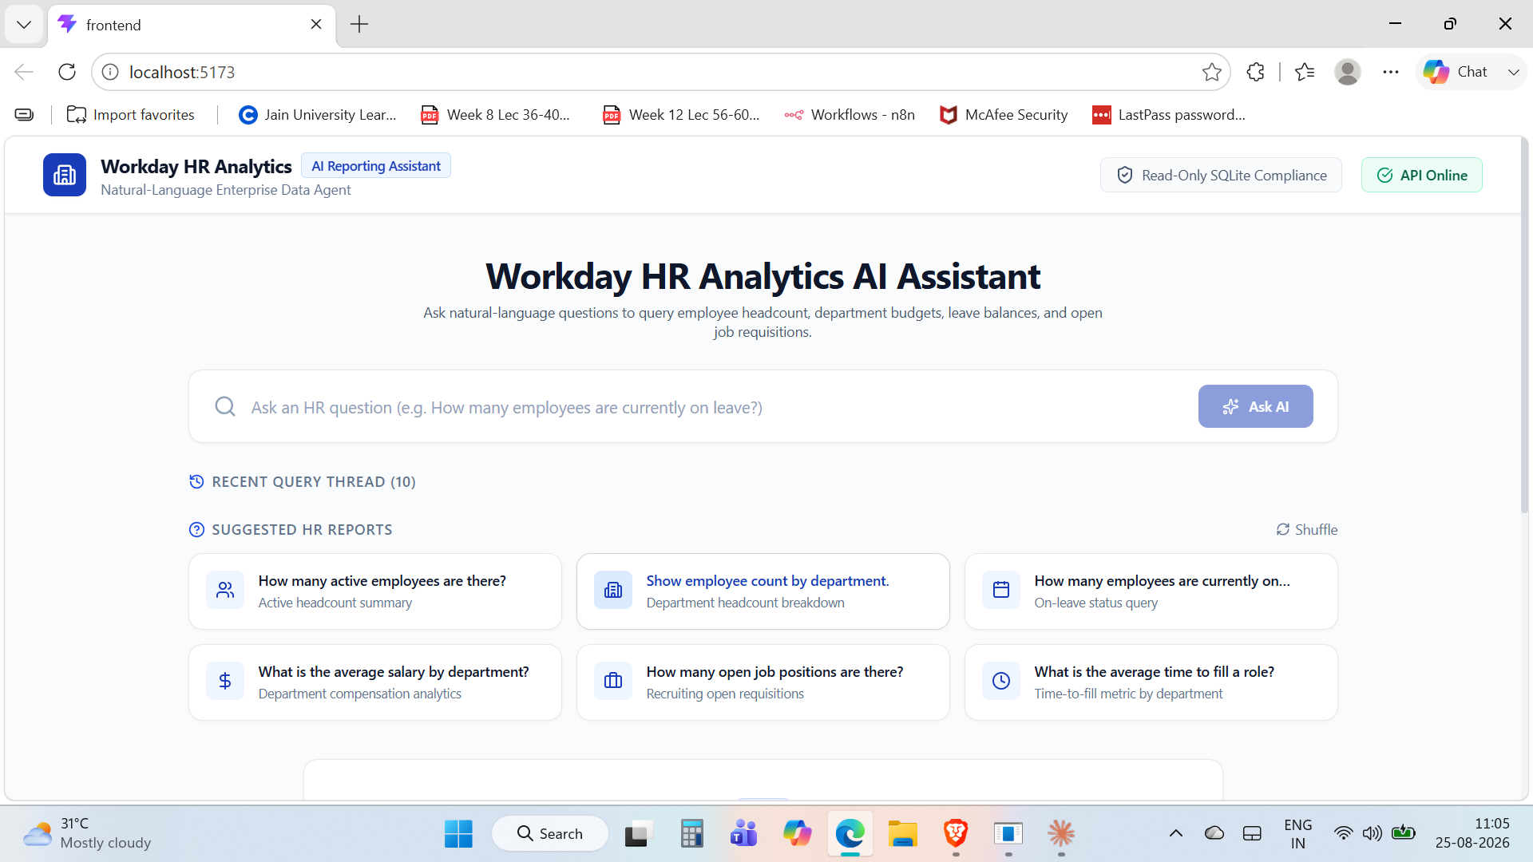
EVALUATION RUBRIC
Success is measured on accuracy, faithfulness, and safety
SQL Generation Accuracy
Generated queries return correct results, verified against a ground-truth query set.
Answer Faithfulness
The final answer reflects actual query results — not invented figures.
Schema-Grounding & Safety
The agent references only real, RAG-retrieved schema and rejects out-of-scope asks, tested with a red-team query set.
08

Slide 8
IMPLEMENTATION STATUS
End-to-end build, across ten phases
Backend (FastAPI, LangGraph workflow, RAG, SQL safety, SQLite) and frontend (React + Vite dashboard) code both exist end-to-end, tracking this phase plan:
Phase 1
Project planning
Phase 2
SQLite DB & synthetic data
Phase 3
FastAPI backend foundation
Phase 4
Data dictionary
Phase 5
Schema RAG (ChromaDB)
Phase 6
SQL generation
Phase 7
SQL validation & execution
Phase 8
LangGraph workflow
Phase 9
Answer generation & faithfulness check
Phase 10
React frontend
Next: expand the ground-truth and red-team query sets, and run the RAGAS faithfulness evaluation end-to-end.
09

